Slide 1

Soccer Match Result Prediction
Min and Ningning
Notes:
Hi
My name Is Min and this is Ningning.
We have made a series of progress and are proud to present to you our project on soccer match result prediction.

Slide 2
Scientific Question
Predict a soccer match outcome based on previous games
Find the best model that yields the highest prediction accuracy
Notes:
Our goal in this project is to predict the outcome of a soccer match.
At first, we thought of making a prediction based on player and team performance statistics. We believed that a team with strong leadership and good players will win over a less organized and bad players. However, after reviewing the data set, we realized that there are too many missing player information, so we moved on to a prediction based on previous games.
This approach makes sense because a team with a three game winning streak is more likely to win the next match than a team with a losing streak.
As for implementation, rather than selecting one specific model for prediction, we decided to run the analysis on many different models so that we can compare and find the best model for soccer match prediction.
We wanted to identify the strengths and weaknesses of each model and find the best model that yields the highest prediction accuracy.

Slide 3
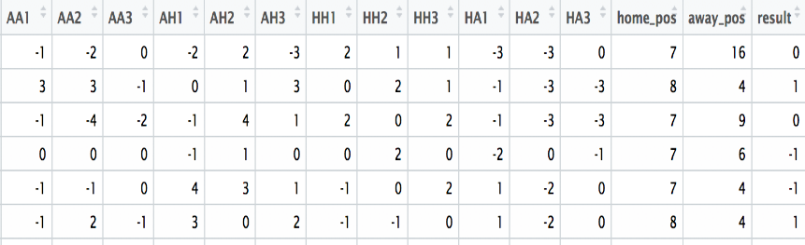
Data
Source: European Soccer Database in Kaggle
Description: over 25,000 matches from 2008 to 2016 in 11 countries
Features: goal differences in past three games and weekly league position of the home and away team
Response: result of the match
Notes:
We obtained the data from Kaggle. It contains information of over 25,000 matches from 2008 to 2016 in 11 different countries.
Originally, the data comes with raw information such as the date of the match, the number of goals for the home team and the away team.
From this raw data, we generated our features and response.
For our features, AA, AH, HH, HA are past game results for the away team and the home team when they played away and home.
Since the last presentation, we added two new features, home_pos and away_pos. Professor suggested that we include league position of each team in our models and we added two columns that show each team’s weekly standing before the match.
For our response, result indicates the result of the match with 1 being home team win, 0 being a draw, and -1 being away team win.

Slide 4
Model setup
Validation: partitioned 20% of the whole dataset as a test set after set.seed(222)
Feature selection:
Result: adding league position features improves all models
Model selection: compare models that include league position
Used past three games
Added league position respectively
Used past four games
Notes:
Let me explain our model setup.
In every model, we partitioned 20% of the data set as a test set. For consistency reason, we used set.seed function before subsetting the data. This way, we can compare different models more objectively.
Our features have changed over time. First, we used past three games for the home and away team. Then we used past four games. Most recently, we added league position features in each of three game and four game data set.
The result of analysis indicated that adding league position features improves the accuracy of all models.
Hence, we disregarded the earlier models and only compared the models that include league position variables.

Slide 5
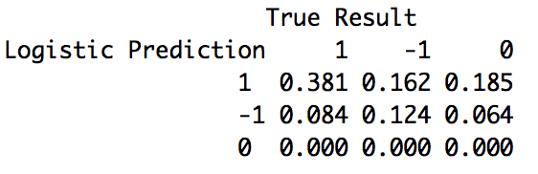
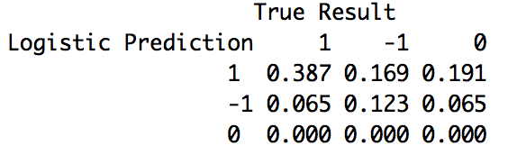
Multinomial Logistic Regression
Rationale: categorical response (-1, 0, 1)
Accuracy: 50.5% (past 3 games) & 51.0% (past 4 games)
Confusion matrices
3 past games without cross validation
4 past games without cross validation
Notes:
First, we used multinomial logistic regression for prediction, since our response is categorical and it is the most common classification algorithm.
And here are the some of the results that we produced.
The row indices represent the predicted result and the column indices are true result from the data.
So, the sum of diagonal entries represents the accurate prediction.
<EXPLAIN WHAT OTHER ENTRIES INDICATE>
(1,2) entry indicates the proportion of predicted home win games when the away team actually won, and similarly for the other entries.
You may observe that both confusion matrices have no predicted zero’s.

Slide 6
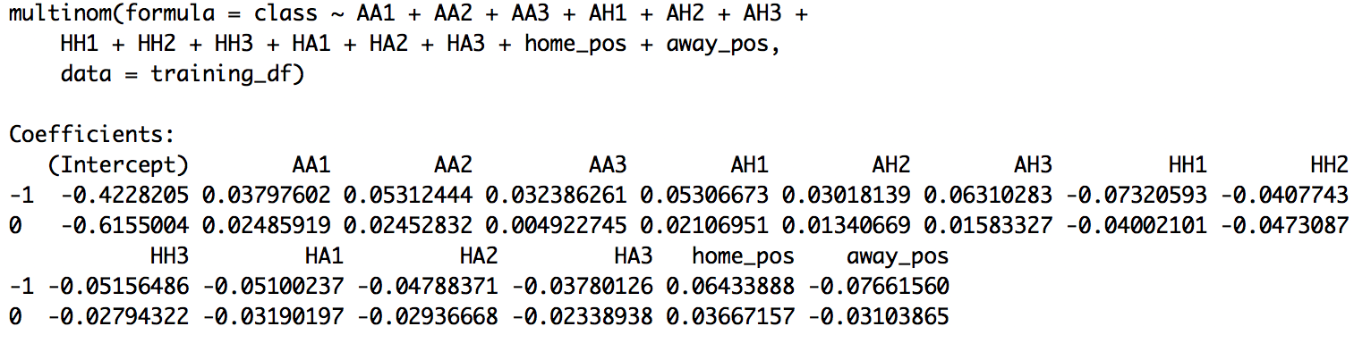
Multinomial Logistic Regression
Interpretation of coefficients
Example: if the away team scored 1 more goal in the previous away game, then the probability of winning for the away team is increased by 3.8% with respect to home team winning
Notes:
This is the result of 3 game logit model.
As you can see, we regressed the result of match on 12 features involving past games and league position variables.
Now I will illustrate how to interpret the coefficients of the regression.
For example, a one-unit increase in the variable ‘AA1’ is associated with the increase in the log odds of ‘away team win’ vs. ‘home team win’ in the amount of .038.
In other words, if the away team scored 1 more goal in the previous away game, then the probability of winning for the away team is increased by 3.8%
So, for -1 category, which is away team win, we see that the coefficients of AA and AH are positive and the coefficients of HH and HA are negative.
For home_pos variable, if the rank of the home team is increased by 1 unit, the chances of away team win is increased by 6.4% and similarly for away_pos variable.

Slide 7
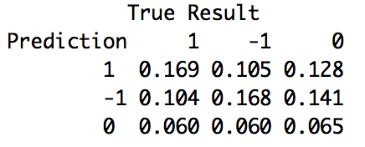
Multinomial Logistic Regression
Problem: no draws predicted
Possible solution: balancing the data set
Confusion matrix
Notes:
Previously, we saw the problem of our multinomial logistic regression model, which is not having zero’s in the prediction.
To fix this problem, we came up with an idea of balancing the data set.
Originally, the result in the training data set is unevenly distributed with 46% of home team wins, 29% of away team wins, and 25% of draws.
We randomly sampled the same amount of games in each category so that the result in the training set has 33% of home team wins, 33% of away team wins, and 33% of draws.
As shown in the matrix, we saw zeros in prediction, although only 18% of the games are predicted as a draw.
We believe that there might not be zero’s in the original data set is due to small proportion of draw games.

Slide 8
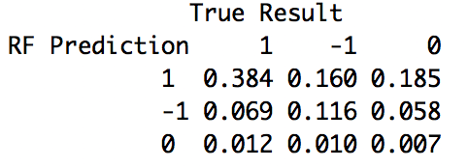
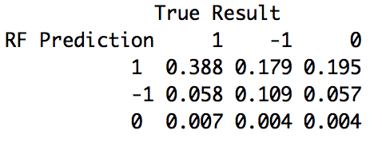
Random Forest
Rationale: a bunch of features and a categorical response
Wishful thinking: observe a draw in the prediction
Accuracy: 50.65% (past 3 games) & 50.04% (past 4 games)
Confusion matrices
3 past games w/ 700 trees
4 past games w/ 700 trees
Notes:
After multinomial logistic regression, we moved on to random forest approach.
We thought it’s a fitting model since we have a bunch of features and a categorical response.
Also, since multinomial logit model did not have any draws in its prediction, we wanted to see if random forest generates a draw in the prediction.
As you can see in this confusion matrix, there are draws in prediction. However, the proportion of draw in prediction is still too small relative to the actual proportion of draw games, which is around 25%.

Slide 9
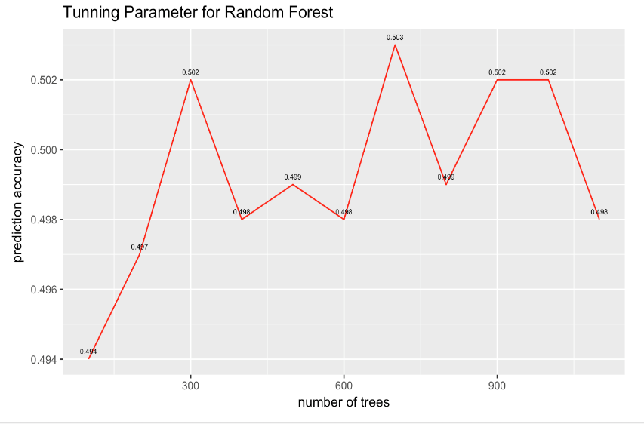
Random Forest
Notes:
This is a plot that shows the accuracy level given a different number of trees.
We started with 100 trees and increased the number of trees by 100 each time.
We see that the highest accuracy is 50.3% at 700 trees. However, the difference after 300 trees is very small and we concluded that the number of trees is not a deciding factor in our prediction model.

Slide 10
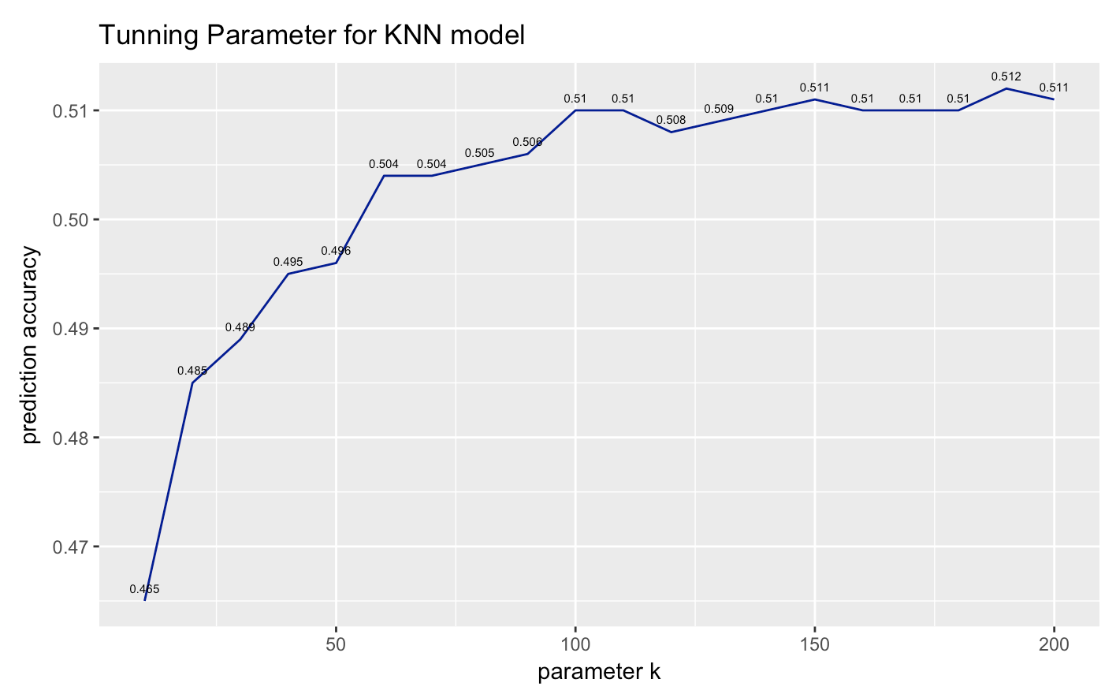
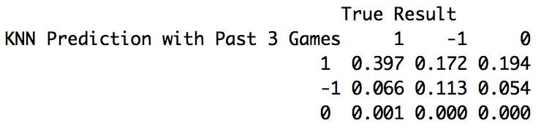
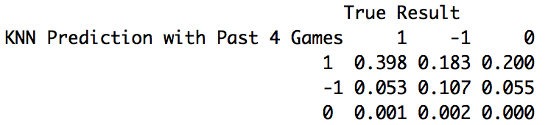
KNN Classification
Rationale: categorical response is good for classification and KNN is a simple model to try
Accuracy: 51.12% (past 3 games) & 50.54% (past 4 games)
Notes:
As we mentioned before, the result is categorical, which means KNN is a simple model we can try with classification.
After tuning the parameter k, the highest accuracy is generated with past 3 games.
This graph is the change of prediction accuracy on test set with respect to different k. The model we used here is the knn model with past 3 games, and the graph for the model with past 4 games is very similar. We can see after k=100, there are not much changes on accuracy. So, we just chose k=190 in our knn model.
These two tables are the confusion matrices for the KNN model with past 3 games and past 4 games. From both matrices, we can see the highest rate of wrong prediction is predicting a draw game as a game won by home team. Also, the highest rate of correct prediction is predicting a home team winning game. Another interesting result is that none of the draw game is correctly predicted, which shows that a draw game is really hard to be predicted correctly.

Slide 11
Naïve Bayes? Maybe not
Kaggle: highest prediction accuracy(55%) achieved by NB model
Accuracy: 44.23% (past 4 games)--below baseline
Problem: model assumption about features’ independence
Possible solution: using principle components as features after PCA
Notes:
In last presentation, we mentioned that the highest prediction accuracy achieved on Kaggle so far is given by naïve bayes model. So, we tried this model with past 3 and 4 games respectively. The prediction accuracy for naïve bayes model with past 4 games is even below the baseline.
After understanding the theories behind the model, we realized that one of the assumption about naïve bayes model is the mutually independence among features. However, our features is highly correlated, since we are using the past games results for prediction.
The person on Kaggle used PCA before fitting the model, so the impact on dependence should be removed. But we didn’t generate as much features as him, and PCA may not be a good choice for us, since the number of features is much smaller than our sample size. In this case, naïve bayes is not a good choice at this stage.

Slide 12
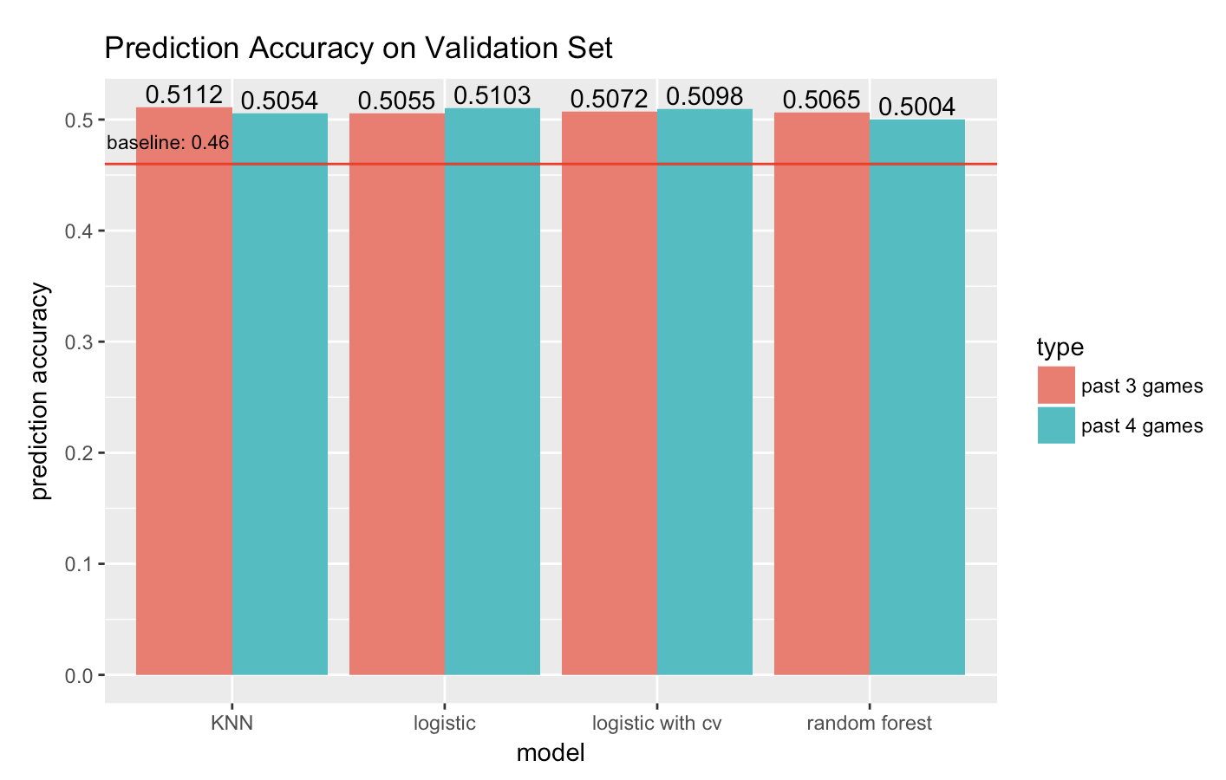
Conclusion
Best Prediction Accuracy: KNN with past 3 games (51.12%)
All models give very similar prediction accuracy (50%-51%)
Adding one additional past game is not very helpful
Overfitting is not occurred, since cross validation is not improving accuracy
Adding good features is the most effective way
Notes:
This graph gives a conclusion about our prediction accuracy among all the models. After adding the league position, the best prediction accuracy is achieved by KNN with past 3 games.
Also, we can see that all models give very similar prediction accuracy, although KNN is slightly better, it is hard to say which classification method is the best.
Another thing is that adding one additional past game does not significantly help improve the prediction accuracy. From the graph, we can see that some models perform better with past 4 games and some do not.
For logistic model, we also tried with cross validation, and you can see from the graph, the prediction accuracy is not changed much. So, overfitting seems not a problem for us.
For this project, the most effective way we found for prediction accuracy improvement is just adding good features. By doing this, our prediction accuracy is improved from 48%, to 50%, and finally to 51%.

Slide 13
For Future Improvement
Adding more features:
Seasonality of the matches
Number of injured players for home team and away team
Write our own multinomial logistic classifier
Modify the object function with higher penalty on wrong prediction for draw games
Notes:
If we have more time to do the project in the future, there are two important things we can try.
One is definitely keeping adding more features. For instance, considering adding the seasonality of the matches and the number of injured players for home team and away team.
The other possible way is to write our own multinomial logistic classifier. Since the number of wrong predictions is highest on predicting draw games, we can modify the object function, and giving higher penalty on wrong prediction for draw games, instead of using the common cross entropy loss function.
That’s it. Thank you.

Slide 14

Thank you !

